Slide 1
Azure Site Recovery
Angel Garcia – Cloud Migration Engineer

Slide 2
AGENDA
Overview of Azure Site Recovery
How Does Azure Site Recovery Work?
How Does 10th Magnitude leverage Azure Site Recovery?
Learn More About Azure Site Recovery!

Slide 3
Overview – Azure Site recovery

Slide 4
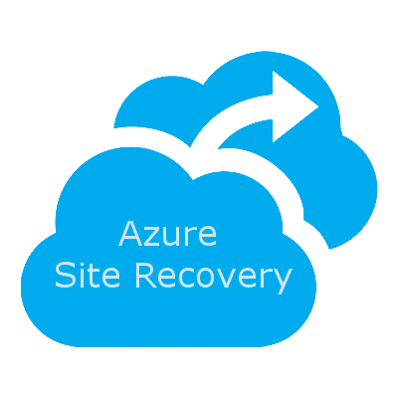
Business continuity and disaster recovery solution
Site Recovery
Keep applications running during outages
Manage On-premises servers and Azure VM replication
Flexible testing and failovers
Supported scenarios
Azure-to-Azure
Hyper V-to-Azure
VMWare-to-Azure
Physical servers-to-Azure
AWS (Windows servers)-to-Azure
Backup
Keep data safe and recoverable
Redundancy Options
What can I backup?
On-Premise workloads
Azure VMs
Azure File Shares
SQL Server in Azure VMs
SAP HANA databases in Azure VMs

Slide 5
How does azure site recovery work?

Slide 6
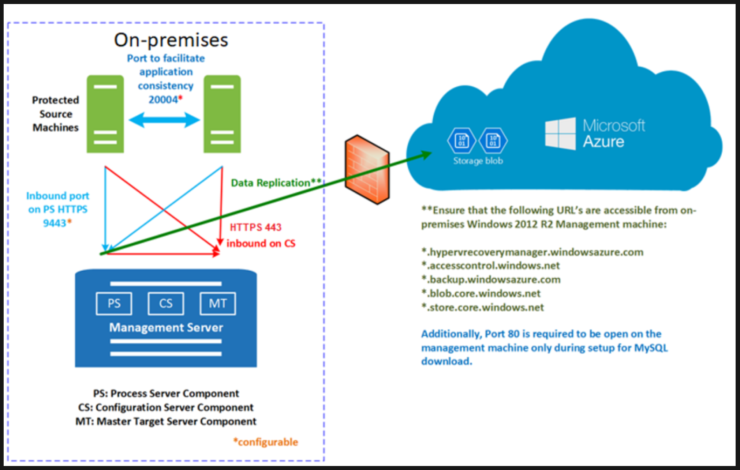
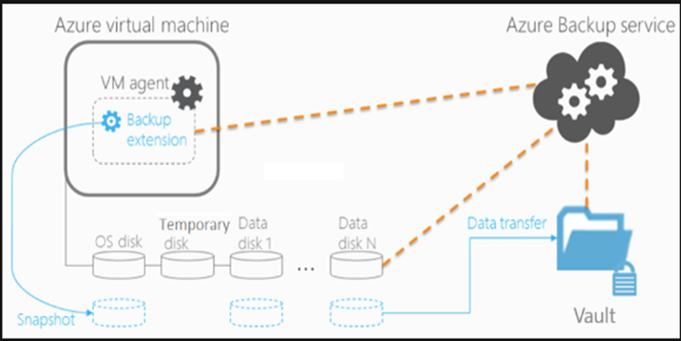
Key components
Site Recovery
On-Premises to Azure:
Configuration/Process Server
Azure Subscription, Storage Account, and Virtual Network
Mobility Agent
Azure to Azure:
Source and Target Resources (VNET, Storage Account(s), Cache Storage account, Availability Sets
Backup
On-Premise to Azure:
Microsoft Azure Recovery Services (MARS) Agent
System Center Data Protection Manager (DPM)
Microsoft Azure Backup Server (MABS)
Azure Backup:
Azure VM Extension
MARS agent

Slide 7
How does 10th magnitude leverage azure site recovery?

Slide 8
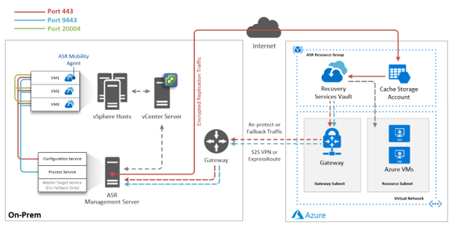
10th magnitude – cloud migration center
Lift-and-Shift Migration
Automation
Reliable onboarding and process management

Slide 9
Interested? Learn more!

Slide 10
Useful links
https://docs.microsoft.com/en-us/azure/backup/backup-overview
https://docs.microsoft.com/en-us/azure/site-recovery/site-recovery-overview

